Slide 1
Chapter 13
Architectural Design
Slide Set to accompany
Software Engineering: A Practitioner’s Approach, 8/e
by Roger S. Pressman and Bruce R. Maxim
Slides copyright © 1996, 2001, 2005, 2009, 2014 by Roger S. Pressman
For non-profit educational use only
May be reproduced ONLY for student use at the university level when used in conjunction with Software Engineering: A Practitioner's Approach, 8/e. Any other reproduction or use is prohibited without the express written permission of the author.
All copyright information MUST appear if these slides are posted on a website for student use.
These slides are designed to accompany Software Engineering: A Practitioner’s Approach, 8/e (McGraw-Hill, 2014). Slides copyright 2014 by Roger Pressman.

Slide 2
Why Architecture?
The architecture is not the operational software. Rather, it is a representation that enables a software engineer to:
(1) analyze the effectiveness of the design in meeting its stated requirements,
(2) consider architectural alternatives at a stage when making design changes is still relatively easy, and
(3) reduce the risks associated with the construction of the software.
These slides are designed to accompany Software Engineering: A Practitioner’s Approach, 8/e (McGraw-Hill, 2014). Slides copyright 2014 by Roger Pressman.

Slide 3
Why is Architecture Important?
Representations of software architecture are an enabler for communication between all parties (stakeholders) interested in the development of a computer-based system.
The architecture highlights early design decisions that will have a profound impact on all software engineering work that follows and, as important, on the ultimate success of the system as an operational entity.
Architecture “constitutes a relatively small, intellectually graspable mode of how the system is structured and how its components work together” [BAS03].
These slides are designed to accompany Software Engineering: A Practitioner’s Approach, 8/e (McGraw-Hill, 2014). Slides copyright 2014 by Roger Pressman.

Slide 4
Architectural Styles
Each style describes a system category that encompasses: (1) a set of components (e.g., a database, computational modules) that perform a function required by a system, (2) a set of connectors that enable “communication, coordination and cooperation” among components, (3) constraints that define how components can be integrated to form the system, and (4) semantic models that enable a designer to understand the overall properties of a system by analyzing the known properties of its constituent parts.
Data-centered architectures
Data flow architectures
Call and return architectures
Object-oriented architectures
Layered architectures
These slides are designed to accompany Software Engineering: A Practitioner’s Approach, 8/e (McGraw-Hill, 2014). Slides copyright 2014 by Roger Pressman.

Slide 5
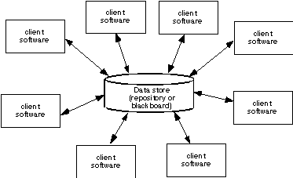
Data-Centered Architecture
These slides are designed to accompany Software Engineering: A Practitioner’s Approach, 8/e (McGraw-Hill, 2014). Slides copyright 2014 by Roger Pressman.

Slide 6
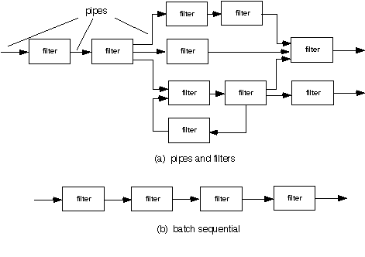
Data Flow Architecture
These slides are designed to accompany Software Engineering: A Practitioner’s Approach, 8/e (McGraw-Hill, 2014). Slides copyright 2014 by Roger Pressman.

Slide 7
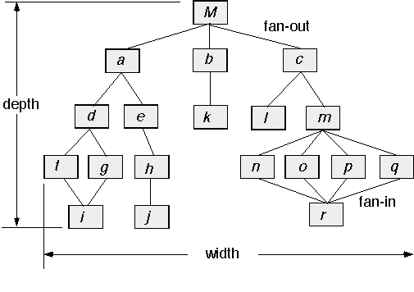
Call and Return Architecture
These slides are designed to accompany Software Engineering: A Practitioner’s Approach, 8/e (McGraw-Hill, 2014). Slides copyright 2014 by Roger Pressman.

Slide 8
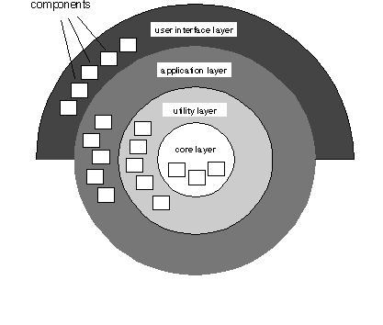
Layered Architecture
These slides are designed to accompany Software Engineering: A Practitioner’s Approach, 8/e (McGraw-Hill, 2014). Slides copyright 2014 by Roger Pressman.

Slide 9
Architectural Patterns
Concurrency—applications must handle multiple tasks in a manner that simulates parallelism
  operating system process management pattern
  task scheduler pattern
Persistence—Data persists if it survives past the execution of the process that created it. Two patterns are common:
  a database management system pattern that applies the storage and retrieval capability of a DBMS to the application architecture
  an application level persistence pattern that builds persistence features into the application architecture
Distribution— the manner in which systems or components within systems communicate with one another in a distributed environment
  A broker acts as a ‘middle-man’ between the client component and a server component.
These slides are designed to accompany Software Engineering: A Practitioner’s Approach, 8/e (McGraw-Hill, 2014). Slides copyright 2014 by Roger Pressman.

Slide 10
Architectural Design
The software must be placed into context
  the design should define the external entities (other systems, devices, people) that the software interacts with and the nature of the interaction
A set of architectural archetypes should be identified
  An archetype is an abstraction (similar to a class) that represents one element of system behavior
The designer specifies the structure of the system by defining and refining software components that implement each archetype
These slides are designed to accompany Software Engineering: A Practitioner’s Approach, 8/e (McGraw-Hill, 2014). Slides copyright 2014 by Roger Pressman.

Slide 11
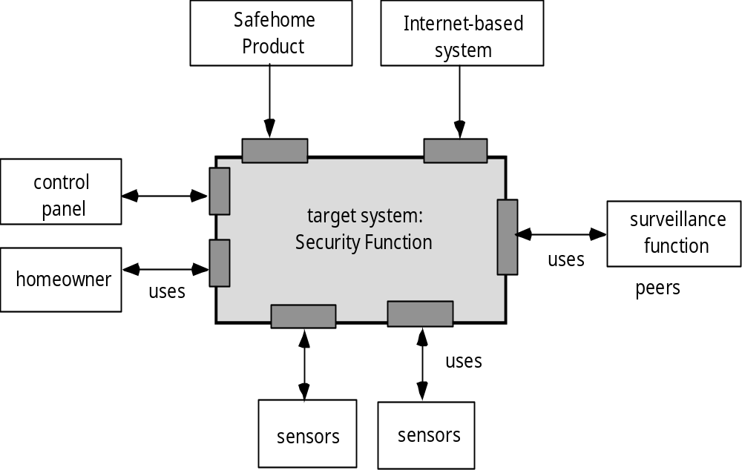
Architectural Context
These slides are designed to accompany Software Engineering: A Practitioner’s Approach, 8/e (McGraw-Hill, 2014). Slides copyright 2014 by Roger Pressman.

Slide 12
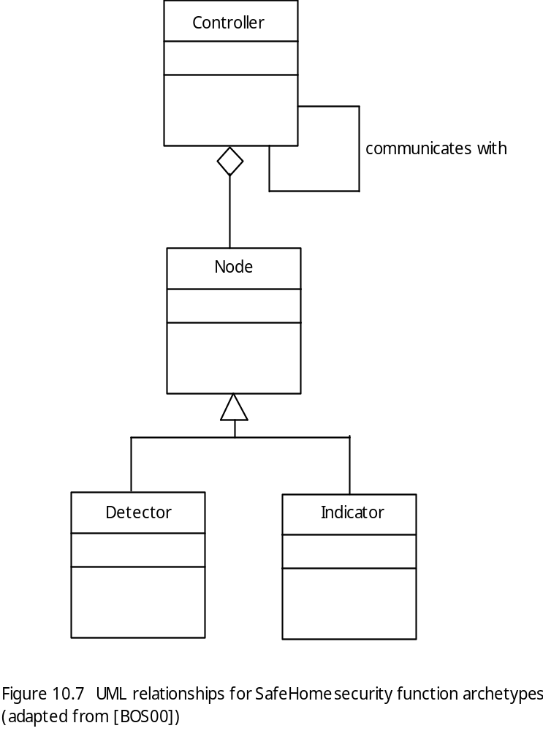
Archetypes
These slides are designed to accompany Software Engineering: A Practitioner’s Approach, 8/e (McGraw-Hill, 2014). Slides copyright 2014 by Roger Pressman.

Slide 13
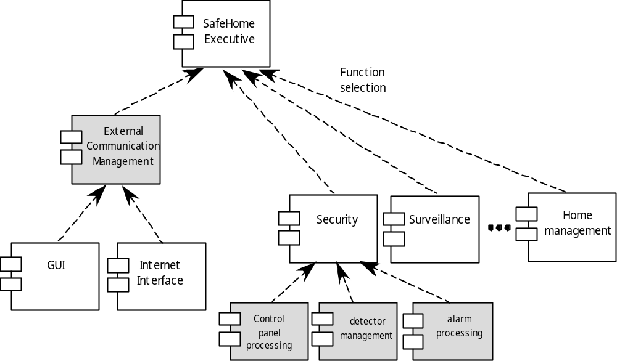
Component Structure
These slides are designed to accompany Software Engineering: A Practitioner’s Approach, 8/e (McGraw-Hill, 2014). Slides copyright 2014 by Roger Pressman.

Slide 14
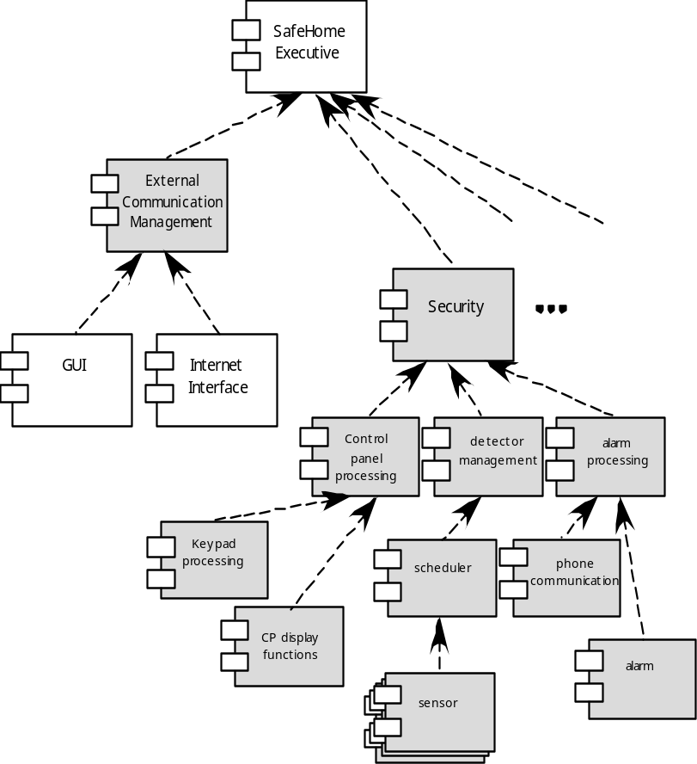
Refined Component Structure
These slides are designed to accompany Software Engineering: A Practitioner’s Approach, 8/e (McGraw-Hill, 2014). Slides copyright 2014 by Roger Pressman.

Slide 15
Architectural Considerations
Economy – The best software is uncluttered and relies on abstraction to reduce unnecessary detail.
Visibility – Architectural decisions and the reasons for them should be obvious to software engineers who examine the model at a later time.
Spacing – Separation of concerns in a design without introducing hidden dependencies.
Symmetry – Architectural symmetry implies that a system is consistent and balanced in its attributes.
Emergence – Emergent, self-organized behavior and control.
These slides are designed to accompany Software Engineering: A Practitioner’s Approach, 8/e (McGraw-Hill, 2014). Slides copyright 2014 by Roger Pressman.

Slide 16
Architectural Decision Documentation
Determine which information items are needed for each decision.
Define links between each decision and appropriate requirements.
Provide mechanisms to change status when alternative decisions need to be evaluated.
Define prerequisite relationships among decisions to support traceability.
Link significant decisions to architectural views resulting from decisions.
Document and communicate all decisions as they are made.
These slides are designed to accompany Software Engineering: A Practitioner’s Approach, 8/e (McGraw-Hill, 2014). Slides copyright 2014 by Roger Pressman.

Slide 17
Architectural Complexity
the overall complexity of a proposed architecture is assessed by considering the dependencies between components within the architecture [Zha98]
  Sharing dependencies represent dependence relationships among consumers who use the same resource or producers who produce for the same consumers.
  Flow dependencies represent dependence relationships between producers and consumers of resources.
  Constrained dependencies represent constraints on the relative flow of control among a set of activities.
These slides are designed to accompany Software Engineering: A Practitioner’s Approach, 8/e (McGraw-Hill, 2014). Slides copyright 2014 by Roger Pressman.

Slide 18
ADL
Architectural description language (ADL) provides a semantics and syntax for describing a software architecture
Provide the designer with the ability to:
  decompose architectural components
  compose individual components into larger architectural blocks and
  represent interfaces (connection mechanisms) between components.
These slides are designed to accompany Software Engineering: A Practitioner’s Approach, 8/e (McGraw-Hill, 2014). Slides copyright 2014 by Roger Pressman.

Slide 19
Agility and Architecture
To avoid rework, user stories are used to create and evolve an architectural model (walking skeleton) before coding
Hybrid models which allow software architects contributing users stories to the evolving storyboard
Well run agile projects include delivery of work products during each sprint
Reviewing code emerging from the sprint can be a useful form of architectural review
These slides are designed to accompany Software Engineering: A Practitioner’s Approach, 8/e (McGraw-Hill, 2014). Slides copyright 2014 by Roger Pressman.

